Slide 1
Course Code: HSC102B
Course Name : Business Communication and Presentation Skills
Course Leader(s): Roopa S Patil
Moderator: ALOK KUMAR SINGH

Slide 2
COMMUNICATION
Communication is the dynamic process of exchange information and ideas.
An active process, it involves encoding, transmitting, and decoding intended messages.
how you say what you say plays an important role in communication.

Slide 3
Communication
55% BODY LANGUAGE
what speaker looks like while delivering a message effects the listener’s understanding most.
38% PARALINGUISTIC
The accent, tone and voice modulation
7% WORDS
Words are only labels and the listeners put their own interpretation on speakers words

Slide 4
Why communication is important?
When working as a team effective communication helps in conflict management and problem solving.
Employers identify communication as one of the basic competencies every graduate should have, asserting that the ability to communicate in valuable for maintaining a successful job performance.
Develop speaking skills
it is the key skill in impression management.
Qualifies one to participate in public life.

Slide 5
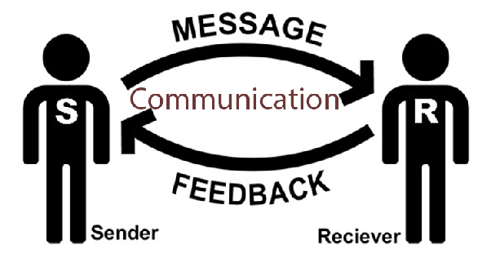

Type of communication
Verbal communicating
- written
-E-mail
- oral
Non-verbal communication
- body language
- expression
- expressive behavior

Slide 6
TYPES OF BODY LANGUAGE
(P)OSTURES & GESTURES
How do you use hand gestures? Stance?
(O)RIENTATION
How do you position yourself?
(E)PRESSIONS OF EMOTION
Are you using facial expressions to express emotion?
(P)RESENTATION
are you using facial expressions to express emotion?
(P)RESENTATION
How’s your “Lighthouse”?

Slide 7
Total communication process
writing 10%
speaking 30%
Listening 45%
Reading 15%

Slide 8
Communication barriers
Lack of motivation and training
Lack of self Awareness
Negative self image
Language and vocabulary level
Lack of preparation
Disagreement between verbal and non-verbal messages
Lack of self confidence
Lack of practice
Unwillingness to Change

Slide 9
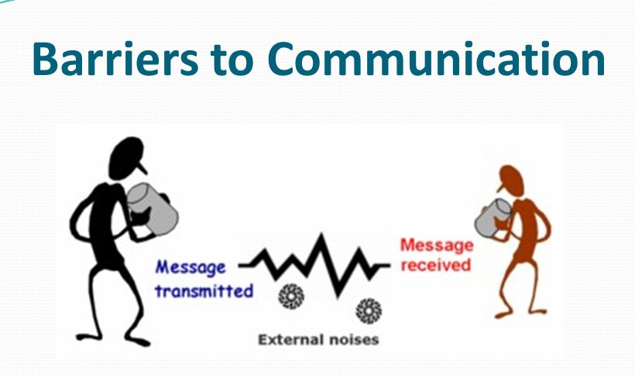
External Barriers in Communication
Environment
The effect of noise
Your company
The venue
Other peoples – status, Education or lack of knowledge at that particulate topic.
Time – for example you have less time to express much things

Slide 10
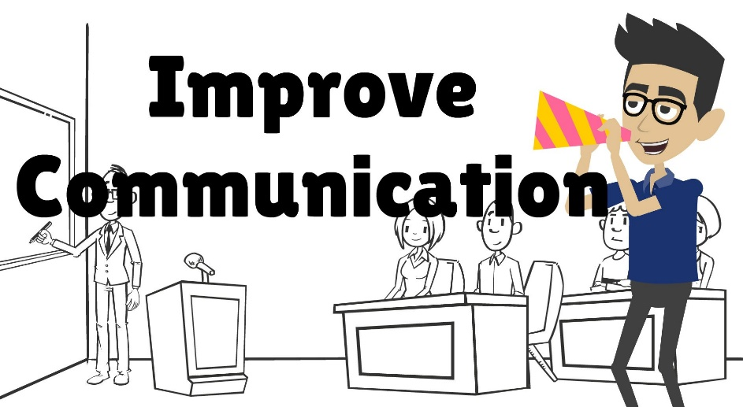
What to DO…..
Make direct eye contact
Speak loud and clear
Stay focused
Listen carefully
Practice it with smile
Always represent your speech by facing towards audience
Stay in the tune with your body language
Own what’s yours
Use ‘I’ messages
Don'ts's give up

Slide 11
BENIFITS
It increase our self-esteem
It helps us to achieve our goals
It minimize hurting and alienating other people.
It helps us to develop mutual respect for each other
It reduce anxiety
It protects us from being taken advantage of by others

Slide 12
THANK YOU

